Slide 1

Ear Train the Brain
Notes:
What NEEDS to be in this presentation?
GET LOGO

Slide 2
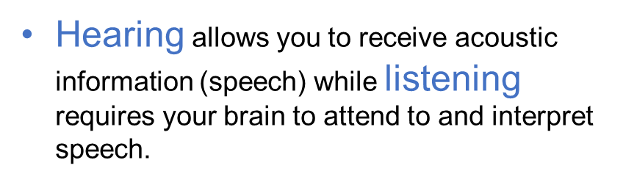
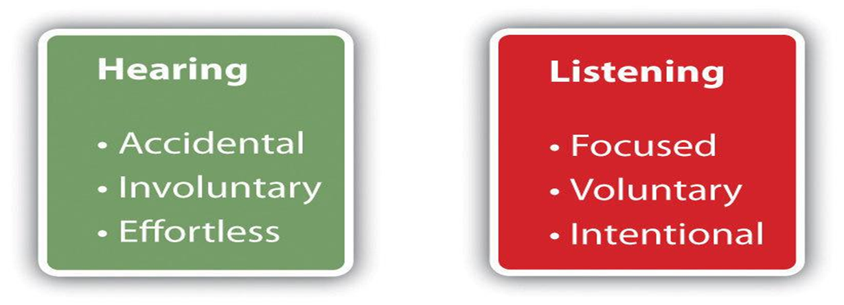
Are hearing and listening the same thing?
Notes:
Once a speech signal enters your ear, your brain must rapidly process each word and hold that string of words in memory long enough to comprehend and make sense of its meaning.
Not only must your brain distinguish each word from all other possible words, but it must invoke mental skills such as auditory memory, auditory attention, and auditory processing speed in order for you to engage successfully in conversation.

Slide 3
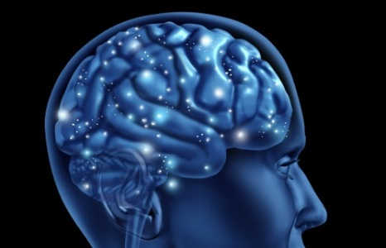
How does hearing loss change my brain?
Neural speech pathways reorganize and rewire themselves.
You may lose tools necessary to process and comprehend speech.

Slide 4
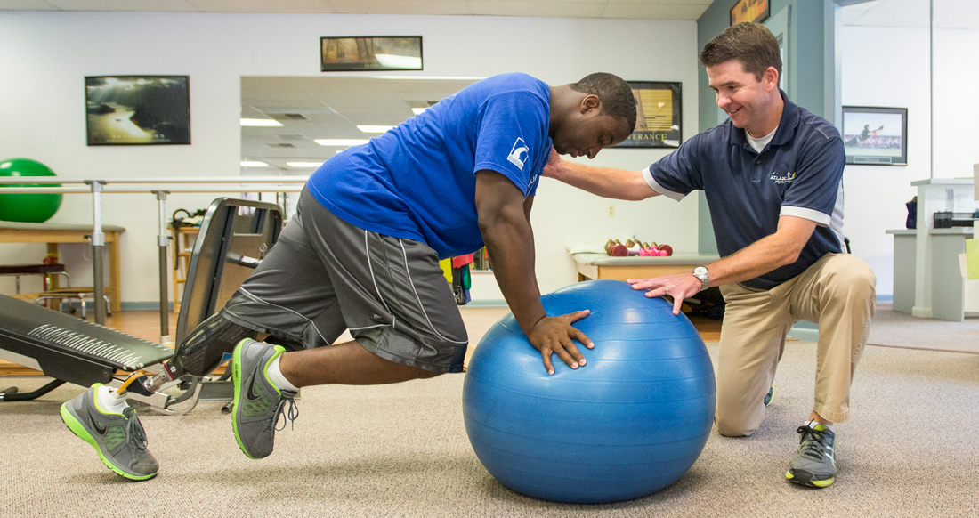
If I begin to use hearing aids, will my brain automatically regain those mental skills that I lost because of hearing loss?
Regaining those skills might take a long time.
You may never become the listener you were before your hearing loss.
Auditory brain training is like physical therapy for the brain.
It trains the brain so you can better comprehend speech.
Notes:
Possibly, but if this does happen, regaining those skills might take a long time and you may never become the listener that you were before you acquired hearing loss. However, help is available. Auditory brain training triggers and accelerates your brain’s rebuilding process. When someone has difficulty walking because of a bum hip and then receives a hip replacement, they receive physical therapy. Auditory brain training is like physical therapy for the brain. It trains the brain so you can better comprehend speech.

Slide 5
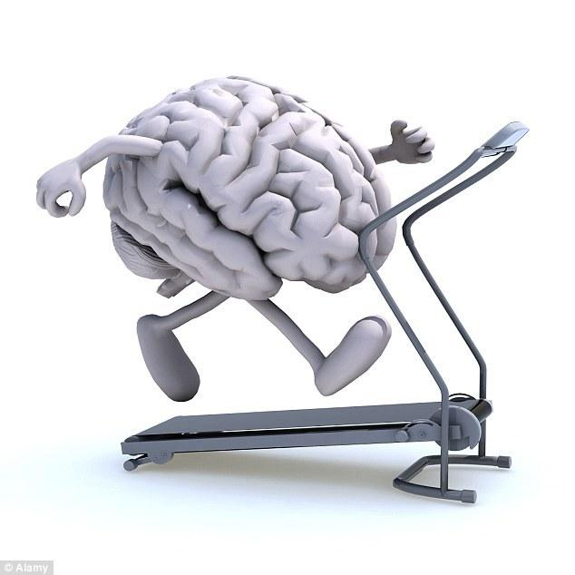
What is auditory brain training?
Helps you recognize frequent words of the language (e.g., “chair”, “table”)
Teaches you to discriminate fine phonetic distinctions (e.g., “can” versus “can’t”)
Trains
auditory working memory
auditory processing speed
auditory attention

Slide 6
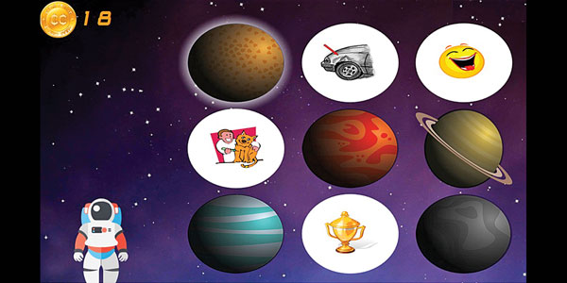
What is clEAR auditory brain training?
Computerized auditory brain training games that are fun to play.
Training that is customized to your specific listening needs.
Coaching and support that is provided by your audiologist.

Slide 7
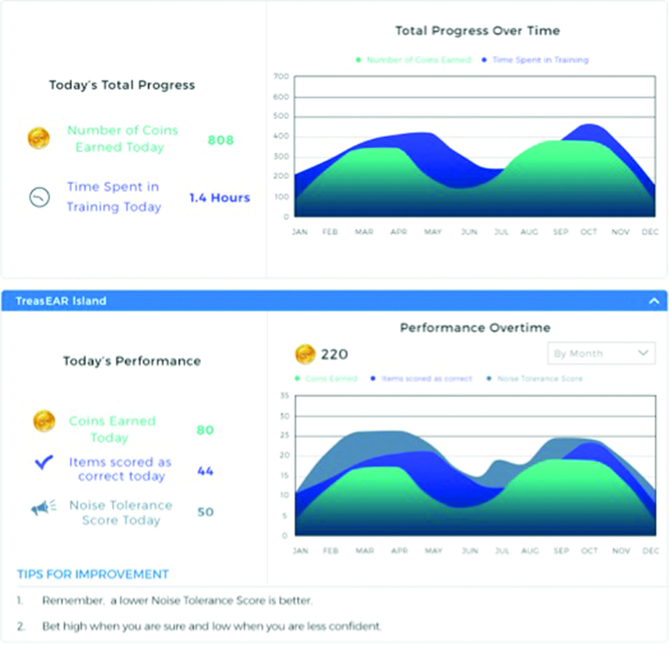
How does it work?
You will get a lesson plan customized for your listening needs.
Access games to train auditory working memory, processing speed and attention.
Play games for 20 minutes 2-3x/week for 12 weeks on your computer or Ipad.
Your audiologist will contact you each week.
Feedback graphs to gauge your success.

Slide 8

What kind of benefits can I receive from clEAR?
Research from Washington University in St. Louis shows that most people:
Improve the ability to recognize speech with background noise.
Experience improved conversational confidence.
Find that it takes less effort to be actively engaged in conversations.
Experience reduced listening challenges

Slide 9
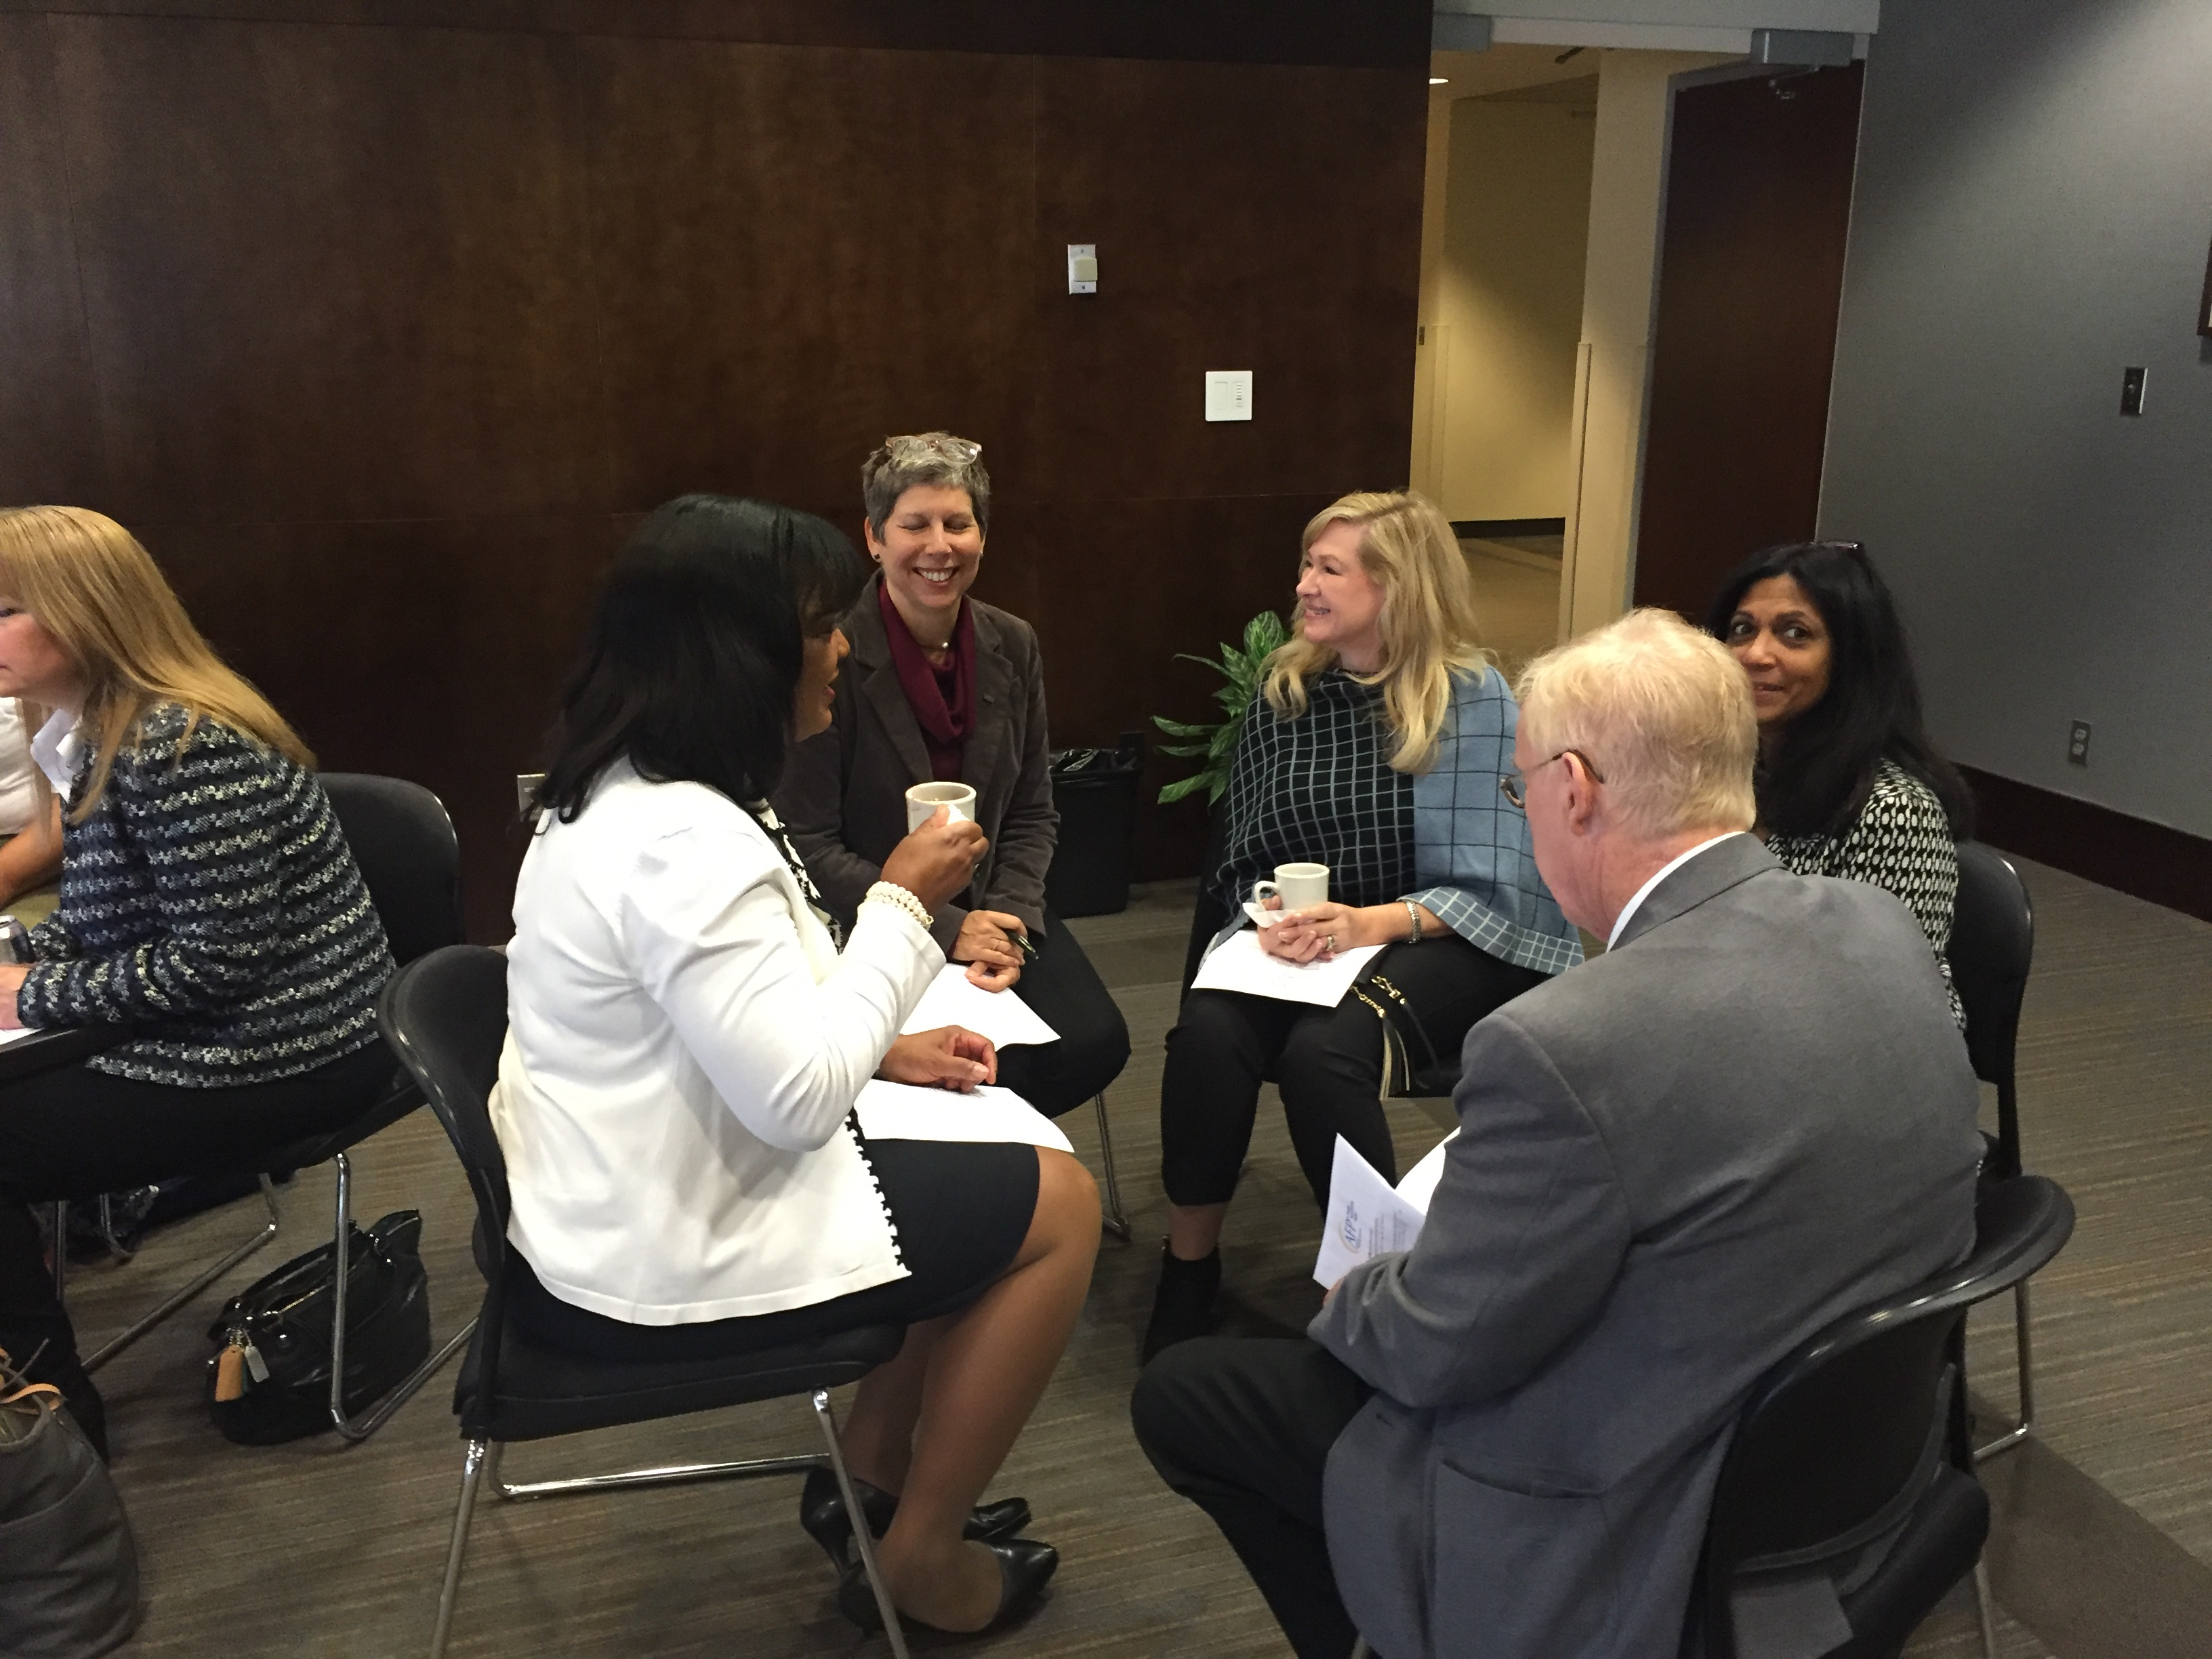
What are people saying about clEAR?
“I was at a wedding reception this past weekend where I was worried that I wouldn't be able to hear the others at my table. I focused intently when speaking to 2 men at the table and was able to hear about 90% of what they said, which was great…better than ever before.”
“Listening is easier now that I’ve trained with clEAR.”
“I loved receiving all of the attention from my audiologist. She really cares about how I’m doing.”
“I would definitely recommend this clEAR program to a friend or relative.”

Slide 10

How do I get started?
Getting started is easy!
Become a subscriber, through your audiologist or directly from home by simply logging on and creating an account.
Your audiologist will provide a weekly lesson plan.
Start training and playing the games right away!
Subscriptions last for 3 months and start when you play for the 1st time.
Extended subscriptions are available and easy to obtain.

Slide 11

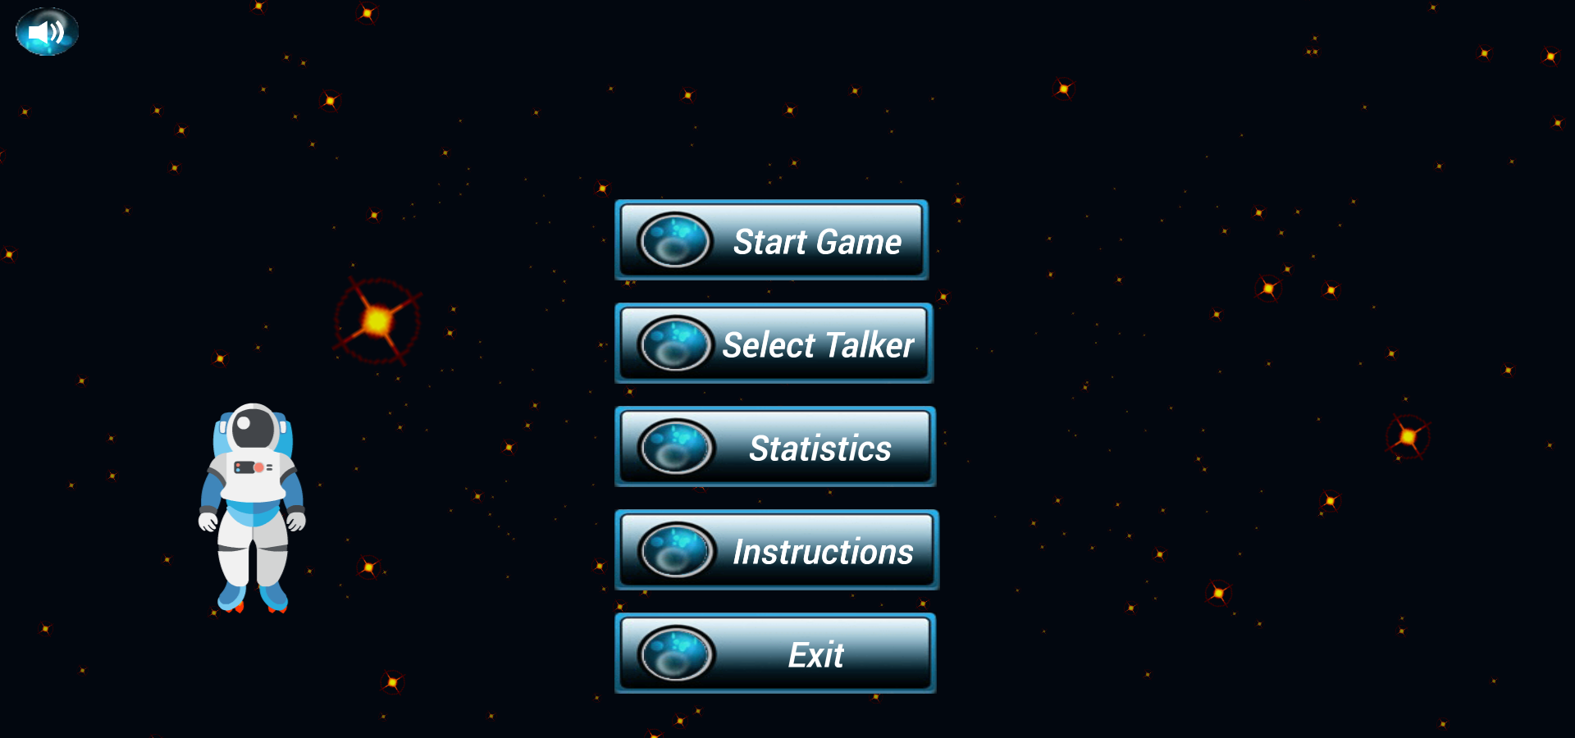
Once you are enrolled
Log in by clicking icon in upper right hand corner.This will take you to your game “dashboard”.
You will see a list of games. Choose which game to play by clicking the “Play now” tab for the game. EARonaut “play now”
Select a talker with the “Select Talker” tab. Once you select a talker, then start playing with the “start Game” tab.

Slide 12
Ear Train the Brain
Notes:
What NEEDS to be in this presentation?
GET LOGO

